Slide 1
Professional Communication

Slide 2
Professional Communication
Textbook:
Business Communication
H.S.Mukherjee
Oxford University Press
Marks Distribution:
MST: 25 marks
EST: 40 marks
Sessional Assessment: 35 marks

Slide 3
Communication
The word communication is derived from the Latin word “communis” which means common.
We spend most of our life communicating.
Therefore it needs proper understanding and application for sophistication of our activities.
Communication is meeting of minds, for transfer of ideas.

Slide 4
A definition of communication
Communication is a process of transfer, exchange, sharing of ideas, thoughts, feelings etc in such a way that the mental picture envisioned by the sender is the same as that perceived by the receiver.

Slide 5
Characteristics of communication
Two way process
Continuous
Essential
Has an objective or a purpose
Pervasive across all walks of life.

Slide 6
The Communication Process
Feedback
Decoding
Receiver
Source
Encoding
Channel
Message
Message
Message
Message
Message

Slide 7
Communication Patterns-Underlying theories
JOHARI WINDOW
Analyses self in relation to others.
Helps increase knowledge about receiver and sender.
Improves interpersonal communication through feedback and disclosure.
TRANSACTIONAL ANALYSIS
Provides explanation of communication patterns.
Helps to recognize Ego states and modify transactions.
Increases successful communication

Slide 8
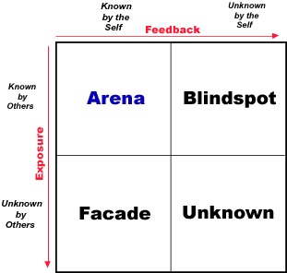

Slide 9
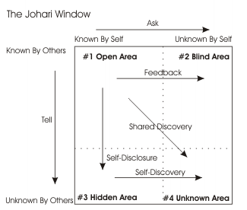

Slide 10
Transactional analysis (Eric Berne – 1910-1970)
It is about analyzing and understanding human communication.
Based on psychoanalytic traditions of Sigmund Freud.
The basic premise is that human personality is constructed of three ego-states.
  Child ego state
  Adult ego state
  Parent ego state
The ego states can be predicted as behavioral states (verbal and non-verbal). Typical behaviors are specific to each ego-state.
10

Slide 11
Transactional analysis
According to Berne, an ego state is a consistent pattern of feeling and experience directly related to a corresponding consistent pattern of behavior.
11

Slide 12
Transactional analysis
The parent is the ego state that contains the external events that were imposed on people in the first five years of their life. These are constructs that are imposed on the child.
Examples would be
'Don't talk to strangers,'
'Always hold a grown-up's hand when you cross the street,' or
'Don't touch a hot stove.'
12

Slide 13
Transactional analysis
The child is the ego state that contains the feelings and emotions related to the external events that were imposed on a person in the first five years of life. These feelings or emotions are replayed in the person's mind when the corresponding external event is recalled.
Examples would be
'Being approached by a strange person makes me feel nervous,'
'I feel safe when I hold someone's hand,' or
'I am scared of being burned.'
13

Slide 14
Transactional analysis
The last ego state is the adult. The adult is the ego state that evaluates what is really going on and makes independent decisions about the world. This ego state begins forming as soon as we gain the ability to control aspects of our environment. It allows a person to compare what they are told about the world with what they feel and experience.
Let's use the hot stove as an example. The adult is told by the parent not to touch a hot stove and recognizes that the child's fear of being burned is reasonable. Therefore, the adult determines to use caution when it's necessary to use a hot stove.
14

Slide 15
Transactional analysis
Parent
There are two forms of Parent we can play.
The Nurturing Parent is caring and concerned and often may appear as a mother-figure (though men can play it too). They seek to keep the Child contented, offering a safe haven and unconditional love to calm the Child's troubles.
The Controlling (or Critical) Parent, on the other hand, tries to make the Child do as the parent wants them to do, perhaps transferring values or beliefs or helping the Child to understand and live in society.
Parent is our TAUGHT concept of life.
15

Slide 16
Transactional analysis
Adult
the Adult in us is the 'grown up' rational person who talks reasonably and assertively,
neither trying to control nor reacting aggressively towards others.
The Adult is comfortable with themself and is the THOUGHT concept of life..
16

Slide 17
Transactional analysis
Child our FELT concept of life.
Free Child: The natural child in all of us.
The Adaptive Child reacts to the world around them, either changing themselves to fit in or rebelling against the forces they feel.
17

Slide 18
Human communication
In transactional analysis the basic unit of communication is termed as stroke.
These strokes may be-
    Positive
    Negative
Stroke is a “unit of human recognition”.
A stroke can be a look, a nod, a smile, a spoken word, a touch. Any time one human being does something to recognize another human being, that is a stroke. Babies need strokes to survive.
Strokes can be positive or negative. Most of us like positive strokes better than negative ones.

Slide 19
Transactions
Transaction is defined as the phenomenon of change of strokes.
As exchange is fundamental to daily human life, the exchange of strokes leading towards different transactions are fundamental to human communications.

Slide 20
Human Interaction Analysis
A transaction = any interaction or communication between 2 people
People send and receive messages out of and into their different ego states
How people say something (what others hear?) is just as important as what is said
Types of communication, interactions
  Complementary
  Crossed
  Ulterior

Slide 21
Complementary ‘Transactions’
Interactions, responses, actions regarded as appropriate and expected from another person.
Parallel communication arrows, communication continues.
Example 1: #1 What time do you have?
#2 I’ve got 11:15.
P
P
A
A
C
C

Slide 22
Complementary ‘Transactions’ cont’d
Example 2:
#1 You’re late again!
P
P
#2 I’m sorry. It won’t happen again.
A
A
C
C

Slide 23
Crossed ‘Transactions’
Interactions, responses, actions NOT regarded as appropriate or expected from another person.
Crossed communication arrows, communication breakdown.
Example 1 #1 What time do you have?
#2 There’s a clock on the wall, why don’t you figure it out yourself?
P
P
A
A
C
C

Slide 24
Crossed ‘Transactions’ cont’d
Example 2 #1 You’re late again!
#2 Yeah, I know, I had a flat tire.
P
P
A
A
C
C

Slide 25
Ulterior ‘Transactions’
Ulterior – existing beyond obvious
Overt (directly observable) and
Covert (more at psychological level) type messages conveyed simultaneously
The hidden messages may be misinterpreted.
P
P
Interactions, responses, actions which are different from those explicitly stated
Example#1 “This car is too racy for you!”
Social level
A
A
Psychological level
C
C

Slide 26
Seven C’s of Effective Communication
Completeness
Conciseness
Consideration
Concreteness
Creativity
Courtesy
Correctness

Slide 27
Completeness
Five W’s
One way to make your message complete is to answer the five W’s.
WHO?
WHAT?
WHEN?
WHERE?
WHY?
The five question method is useful when you write requests, announcements, or other informative messages.
For instance, to order (request) merchandise, make clear WHAT you want, WHEN u need it, WHERE it is to be sent.

Slide 28
Who, what, when, where, why.
Hi everyone,
I just wanted to send you all a reminder about the meeting we're having tomorrow!
See you then,
Mukesh
Hi everyone,
I just wanted to remind you about tomorrow's meeting on the new telecommuting policies. The meeting will be at 10:00 a.m. in the second-level conference room. Please let me know if you can't attend.
See you then,
Mukesh

Slide 29
Completeness
I did not hear from your company, after complaining to the customer care twice.
vs
I had registered a complaint with the customer care (reference number/ complaint numbers 12 and 23) on 16th February 2017, and 23rd February 2017, respectively. Can you please let me know the status of the complaint?

Slide 30
Completeness
I will reach Delhi airport tomorrow.
vs
I will reach Delhi international airport by Jet Airways at 8 a.m. on 25th February 2017.

Slide 31
2) Conciseness
Conciseness means “convey the message by using fewest words”.
“Conciseness is the prerequisite to effective business communication.”
A concise message saves the time and expenses for both the parties.

Slide 32
How To achieve conciseness ?
    For achieving conciseness you have to consider the following.
    Avoid wordy expression
    Include only relevant material
    Avoid unnecessary repetition.

Slide 33
Avoid Wordy Expression
Last financial year, the room sales for our hotel were average, and the figures went up merely by a small percentage. One may list a number of reasons for this performance. Some of the important factors can be the quality of marketing activities undertaken by our company. Moreover, the recession had its impact.
or
The financial year 2016-17 saw a mere 5 percent growth in the sale of rooms, compared to the last financial year. The major reason for this average performance was our inability to tap into the corporate space. The recessionarry trend in the market was another reason.

Slide 34
Avoid Wordy Expression
We are pleased to inform you that the corrected bill that you have sent us looks better than the previous one.
vs
We have received your corrected bill.
Please refer to the email sent by Rahul and you are expected to complete the assignment and send it across by today evening.
vs
With reference to Rahul’s email dated 5th August 2017, please submit your assignments by 5 this evening.

Slide 35
Avoid Wordy Expression
The revenues were up this year by a significant margin.
vs
The revenues were up by 40%.
We deeply regret the fact that the prices are up.
vs
We regret the increase in prices.

Slide 36
Avoid Wordy Expression
E.g. Wordy:- at this time.
Instead of “at this time” you can just use only a concise word:- NOW ,
Always try to use “ To the point Approach” in business scenario perspective.

Slide 37
Avoid filler words/ phrases
"for instance,“
"you see,"
"definitely,"
"kind of,"
"literally,"
"basically,"
"I mean."

Slide 38
Include only relevant information
Always try to provide only relevant information to the receiver of the message.
Lets say one of your customer requested
  for clients of the company
  in reply you should provide simply list of clients at the panel of your company.
  No need to provide detailed business information about client at all.
Observe the following suggestions to “Include only relevant information.”
  Stick to the purpose of message
  Delete irrelevant words
  Avoid long introduction, unnecessary explanation etc.
  Get to the important point concisely.

Slide 39
Avoid unnecessary repetition
Sometimes repetition is necessary for focusing some special issue.
But when the same thing is said two or three times without a valid reason, the message becomes wordy and boring.
That’s why we should try to avoid unnecessary repetition.

Slide 40
Some ways to eliminate unnecessary words
Use shorter name after you have mentioned the long once. e.g.
Spectrum communications Private limited use Spectrum.
Use pronouns or initials E.g.
Instead of World Trade Organization use WTO or You can use IT for Information Technology.(keeping in view that receiver knows about these terms)

Slide 41
3) Consideration
Consideration means – To consider the receiver’s Interest/Intention.
It is very important in effective communication while writing a message you should always keep in mind your target group

Slide 42
Three specific ways to indicate consideration
i-Focus on “you” instead of “I” or “We”
ii-Show audience benefit or interest of the receiver
iii-Emphasize positive, pleasant facts.
Using “you” helps you, but over use lead a negative reaction.

Slide 43
Always write a message in such a way as to show how audience should be benefited from it.

Slide 44
We attitude
We are delighted to announce that we will extend to make shopping more enjoyable and longer...
You attitude
“You will be able to shop in the evening with the extended hours.”

Slide 45
Readers may react positively when benefits are shown to them.
Always try to address his/her need and want.
Always show/write to reader………… what has been done so far as his/her query is concerned.
Always avoid that has not been done so far.

Slide 46
4) Concreteness
It means that message should be specific instead of general. Misunderstanding of words creates problems for both parties (sender and receiver).
When you talk to your client always use facts and figures instead of generic or irrelevant information.

Slide 47
General
He is very intelligent student of class and stood first in the class.
vs
Concrete
Rahul’s GPA in B.Tech. Electrical Engineering 2014 even semester was 3.95/4.0; he stood first in his class.

Slide 48
Creativity
Message able to hold attention of receiver.
Use of images, charts etc creatively.
Expression that is non-routine and out of the box.

Slide 49
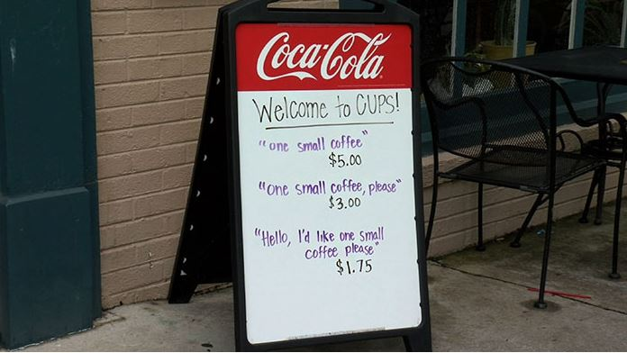
A creative way of saying…

Slide 50
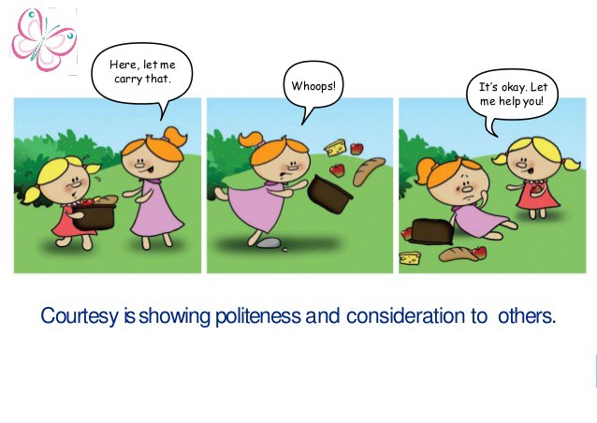
Courtesy

Slide 51
Email 1
Ramesh,
I wanted to let you know that I don't appreciate how your team always monopolizes the discussion at our weekly meetings. I have a lot of projects, and I really need time to get my team's progress discussed as well. So far, thanks to your department, I haven't been able to do that. Can you make sure they make time for me and my team next week?
Thanks,
Suresh

Slide 52
Email 2
Hi Ramesh,
I wanted to write you a quick note to ask a favor. During our weekly meetings, your team does an excellent job of highlighting their progress. But this uses some of the time available for my team to highlight theirs. I'd really appreciate it if you could give my team a little extra time each week to fully cover their progress reports.
Thanks so much, and please let me know if there's anything I can do for you!
Best,
Suresh

Slide 53
How to generate a Courteous Tone ?
The following are suggestions for generating a courteous tone:
Be tactful and sincerely appreciative.
Use expressions that show respect for the others.
Choose nondiscriminatory expressions.

Slide 54
Tactless, Blunt | More Tactful
Stupid letter; I can’t understand. | Could you please explain it once again ..?
Its your fault, you did not properly read my latest email. | Let me try if I can change my wording to make you understand better.

Slide 55
Never use offensive words
This report is useless
Your behaviour was irresponsible.
Your laziness towards work has created all this mishap.
This report needs more clarity.
You will need to behave more professionally.
A little more focus on work would have been more productive.

Slide 56
Choose nondiscriminatory expressions
Use gender-neutral words
  Neutralise any reference to gender, like using "they" as a third person singular pronoun instead of "he" or "she”
  or instead of using ‘he’, use he/she or s/he
  Use gender-neutral words like chairperson (instead of chairman) or police officer (instead of policeman)
Use appropriate disability wording
(respectful disability language is important)
Do not mention age

Slide 57
When talking about disability
Do not refer to a person's disability unless it is relevant. For example, don’t ask “What’s wrong with you?” or refer to the “girl in the wheelchair”.
Use "disability" rather than "handicap" to refer to a person's disability. When talking about or referring to parking spaces or bathroom stalls used by people with disabilities say "accessible" or “disabled” parking or “accessible” or “disabled” access stall.
Never use "cripple/crippled" or “mental” when talking about disability in general or the person.
Don't portray people with disabilities as overly courageous, brave, special, or superhuman. This makes it sound like it is unusual for people with disabilities to have talents, skills or to live life like everyone else.
Don't use "normal" to describe people who don't have disabilities. It is better to say "people without disabilities” if necessary to make comparisons.

Slide 58
Words to use and avoid regarding disabled
AVOID:
Crazy, insane • Cripple, lame • Handicapped, physically challenged, special • Retarded, slow • Wheelchair-bound• Brain-damaged • Dwarf, midget, little person • Invalid, deaf, dumb, deaf-mute • Deformed
USE:
Psychiatrically disabled • Disabled • Cognitively disabled • People with disabilities • Visually impaired, Hearing-impaired • Wheelchair user • Someone of short stature • Developmentally disabled • Learning disabled

Slide 59
7) Correctness
At the core of correctness is proper grammar, punctuation and spelling.
however, message must be perfect grammatically and mechanically
. The term correctness, as applied to business messages also mean three characteristics
Use the right level of language
Check the accuracy of figures, facts and words
Maintain acceptable writing mechanics

Slide 60
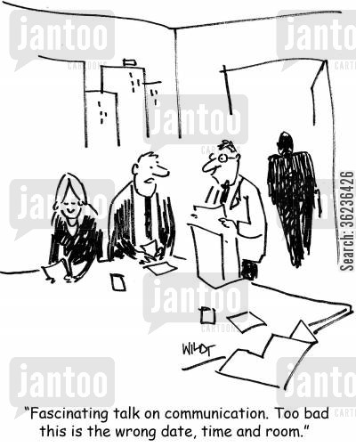
Correctness

Slide 61
Use the right Level of Language
Three levels of language
Formal
Informal
Substandard.

Slide 62
Formal and Informal Words
Formal writing is often associated with scholarly writing: doctoral dissertations, scholarly, legal documents, top-level government agreements and other material where formality is demanded.
Informal writing is more characteristic of business writing. Here you use words that are short, well-known and conversational as in this comparison list:
More Formal less formal
Participate Join
Endeavor try
Ascertain find out
Utilize use
Interrogate question

Slide 63
Substandard Language
Avoid substandard language. Using correct words, incorrect grammar, faulty pronunciation all suggest an inability to use good English. Some examples follow:
Substandard More Acceptable
Ain’t isn’t,aren’t
Can’t hardly can hardly
Aim to proving aim to prove
Desirous to desirous of
Stoled stolen

Slide 64
Facts and Figures Accuracy
Check Accuracy of Facts, Figures and words
It is impossible to convey meaning precisely, through words, from the head of the sender to a receiver. Our goal is to be as precise as possible, which means checking and double-checking to ensure that the figures, facts and words you use are correct.
Figures and facts
Verify your statistical data
Double-check your totals
Avoid guessing at laws that have an impact on you, the sender and your organization.
Have someone else read your message if the topic involves data.
Determine whether a “fact” has changed over time

Slide 65
Proper Use of Confusing Words!
Our Language (Any) is constantly changing. In fact,even dictionaries can not keep up with rapid change in our language. the following words often confusing in usage:
A, An use a before consonants and consonants sounds or a long ” u” sound. Use an before vowels.
Accept, except accept is a verb and means to receive. except is a verb or a preposition and relates to omitting or leaving out.
Anxious, eager Anxious implies worry, eager conveys keen desire

Slide 66
Proper Use of Confusing Words!
Adopt/ adapt
Advise/ advice
Affect/ effect
Allusion/ illusion
Principal/ principle
Compliment/ complement
Criterion/ criteria
Phenomenon/ phenomena
Fortunate/ fortuitous
Idol/ idle
Desert/dessert

Slide 67
Making Communication Effective
Implementing 7 Cs of Communication.
Focus on your audience. (primary, secondary)
Keep the messages short and simple.
Giving and receiving feedback the right way.

Slide 68
Challenges while sending and receiving a message
Unclear ideas
Wrong or inappropriate medium
Noises or breakdowns during communication
Message ignored or missed due to information clutter
Meaning of messages not interpreted the way they were meant
Low impact of messages and consequent poor response.

Slide 69
Challenges while sending a message
Unclear ideas
Many messages to be addressed.
Multiple thoughts in the same message.
SOLUTION:
- Stay focused on your message and the reason for sending it (purpose of sending the message).
- Communicate different pieces of information with separate messages.
- Do not combine messages and confuse the audience.

Slide 70
Challenges while sending a message
Wrong or inappropriate medium
  Use suitable media
  Each medium has its uses and shortcomings.
  Check requirements: type of message, speed, documentation
Noises or breakdowns during communication
- Barriers

Slide 71
Challenges while receiving a message
Message ignored or missed due to information clutter
  Solution: target the right audience
  Message should be easy to grasp
Meaning of messages not interpreted the way they were meant
  Be objective and concrete
Low impact of messages and consequent poor response.

Slide 72
Barriers to Communication
Sender oriented barriers Sender’s way of framing the message, language, interpersonal behaviour, attitude, frame of reference, complexes, editing, distortion of message, perceptual bias.
Verbal and non-verbal barriers Linguistic, semantic, punctuation, wrong selection of medium, poor vocabulary, emotions, signs, body language.
Cross cultural barriers difference in approaches to communicate due to cultural nuances.
Physical barriers noise, filters, failure of communication channels, age, gender, distance.

Slide 73
Framing a message!
You have two sides, one out in the field and one in. Each man that's in the side that's in goes out, and when he's out he comes in and the next man goes in until he's out. When they are all out, the side that's out comes in and the side that's been in goes out and tries to get those coming in, out. Sometimes you get men still in and not out.
When a man goes out to go in, the men who are out try to get him out, and when he is out he goes in and the next man in goes out and goes in. There are two men called umpires who stay out all the time and they decide when the men who are in are out. When both sides have been in and all the men have been out, and both sides have been out twice after all the men have been in, including those who are not out, that is the end of the game.

Slide 74
Language and semantics
Different languages, different dialects
Semantics: the study of meanings in language
  Lie, date, set, Braces, God
  Rain, rein, reign / quite, quiet/ no, know.
Punctuation
  Godisnowhere
  A woman, without her man, is nothing.
  A woman: without her, man is nothing.

Slide 75


Slide 76
Cross cultural barriers
Difference in approaches to communicate due to cultural nuances.
‘soon’,
‘eye contact’,
time,
‘swastika’ ,
stereotypes,
ethno-centricism

Slide 77
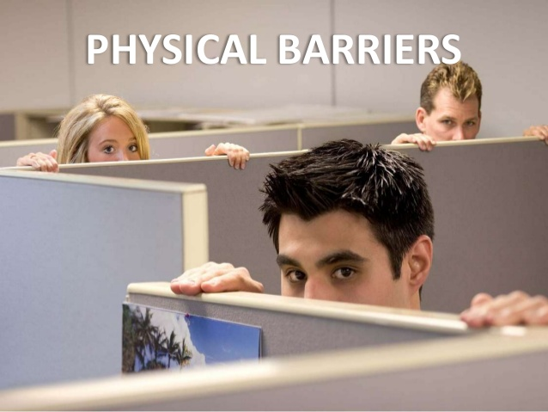

Slide 78
Physical barriers
Noise
  Poor acoustics
  People chatting
  Physical/ mental/ written/ visual noise
Filters
  Blockages that prevent message from being received.
  Junk/ spam filters
Failure of communication channels
Distance e.g. staff sitting in different buildings
Gender, Age

Slide 79
Gender differences
Women talk about other people. Men talk about tangible things like business, sports, food and drinks.
Women ask questions to gain an understanding. Men talk to give information rather than asking questions.
Women are more likely to talk to other women when a problem or conflict arises. Men are often known for dealing with problems or issues internally.
Women focus on feelings, senses and meaning. They rely on their intuition to find answers. Men focus on facts, reason and logic. They find answers by analyzing and figuring things out.
A disagreement between women affects many aspects of their relationship and may take a long time to resolve. Men can argue or disagree and then move on quickly from the conflict.

Slide 80
Emotional barriers
Anger - Anger can affect the way your brain processes information given to you. For example, angry people have difficulty processing logical statements, limiting their ability to accept explanations and solutions offered by others
Pride - The need to be right all the time will not only annoy others, it can shut down effective communication. For example, you might focus only on your perspective, or you might come up with ways to shoot down other people before you even listen to their points.
Anxiousness - Anxiety has a negative impact on the part of your brain that manages creativity and communication skills. For example, your constant worries can hinder your ability to concentrate on the information you are giving or receiving.

Slide 81
Psychological barriers
Lack of attention
Distrust
A closed mind
Being judgmental

Slide 82
Perceptual barriers
Perceptual Barriers - when our perception is different from the reality.
Perceptual Bias
Occurs when our perception is different from the reality
Perceptual bias is the lens we automatically filter all of our experiences through.
It might make some things seem more noteworthy than others.
Thus, a perception bias is a psychological tendency to lose objectivity in perception of people and situations.

Slide 83
Perceptual barriers
Halo effect: an example of perceptual bias
The halo effect is a type of perceptual bias in which our overall (general) impression of a person influences how we feel and think about his or her character.
Essentially, your general impression of a person ("He is nice!") impacts your evaluations of that person's other traits (You may assume that: "He is also smart, intelligent and efficient.").

Slide 84
Oral Communication
Part of verbal communication that involves only speaking and not writing.
Is an instant process
At least two parties
Strongly affected by non-verbal cues.
It usually has no proof.

Slide 85
Principles of Oral Communication
Accuracy
- correct content and data
Precision
- “roughly around 4 p.m.”
Clarity
  - organize your thoughts
  - pause between ideas
Courtesy

Slide 86
Formal and informal oral communication
Formal
Involves official contexts
Can be within two individuals or within groups
Keep a recorded proof of the conversation e.g. a follow up e-mail.
Be cautious of what you say.
Informal
Involves both official or non official contexts
Can be within individuals and groups.
Do not contribute to gossip or useless discussions.

Slide 87
Advantages and disadvantages
Advantages
Effective way to communicate with large audiences
Time saver
generates immediate feedback
opportunity to persuade.
opportunity for immediate clarification and/or message modification.
best for conveying feelings and emotions
Disadvantages
has no proof
may lead to misunderstanding
not suitable for long,complicated messages.
physical distance might be a barrier despite technical facilities.
too dependant on non-verbal cues.
demands ability to think coherently as one speaks.

Slide 88
When to use oral communication
When feelings, emotions need to be expressed.
For persuasion,motivation and counselling.
When decisions need to be transferred quickly throuout the organisation.

Slide 89
Oral communication and behavioural patterns
Dominant-have an 'I' attitude; try to dominate people, would like to take all the credit.
Passive-very silent; speak only when spoken to; usually ignored by people.
Pessimists and objection raisers-negative attitude; see only the dark side; will try to convince why not to do something.
Optimists- too much optimism; build castles in the air; ignore reality.
Advisers and sympathisers – know-alls; give advice even when not needed.
Diplomats-leave things hazy; switch sides in inconvenient situations.

Slide 90
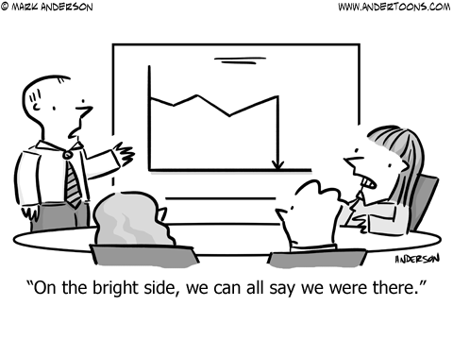
Optimism

Slide 91
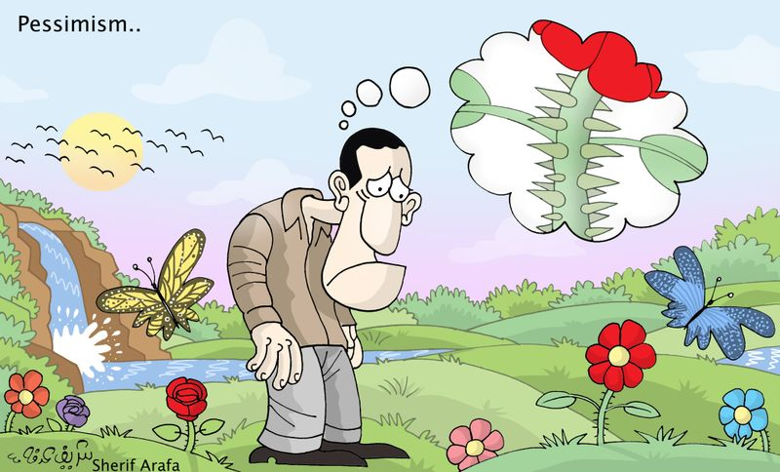

Slide 92
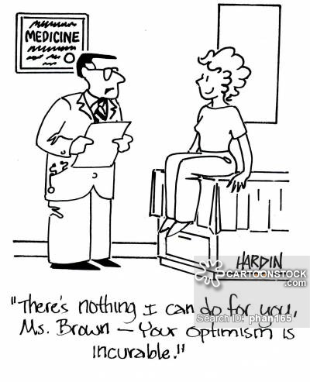
Optimism

Slide 93
Strategies to handle different communication styles
Dominant-Listen carefully but take decisions based on consensus and careful thought.
Passive-encourage them to speak; make them feel a part of the group; probe to find out their viewpoints.
Pessimists-do not shun them but do not get carried away; stern handling if the problems are being highlighted constantly.
Optimists-be overcautious and keep the ground realities in mind.
Advisers-Try to move them out of the situation if advice is out of context or place.
Diplomats-press them for a definite answer or a decision with justification if they are not forthcoming.

Slide 94
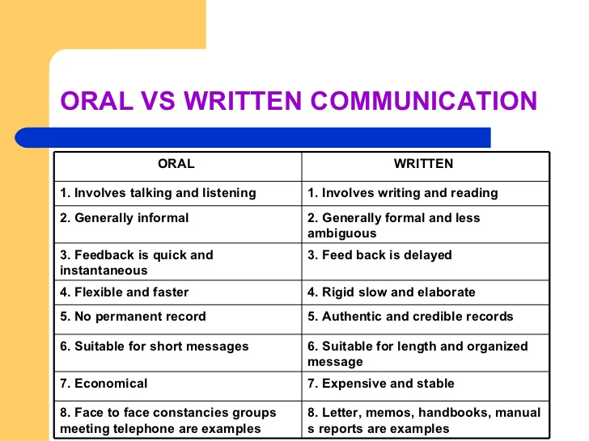

Slide 95
Importance of Feedback
We may say that communication has occurred only when the message has been understood.
Understanding occurs in the mind of the receiver.
Feedback is critical to ensure that accurate understanding of the message has occurred.

Slide 96
Constructive and Destructive feedback
Constructive
tries to imrove the current situation.
positive and correct tone of message.
e.g-The design needs to be reviewed from the practical angle and minute issues.
Destructive
Derogatory
Hurting
Harmful
e.g-This design is absolutely useless and impractical and lacks attention to little details.

Slide 97
Feedback
Some points while giving feedback:
Avoid giving bitter feedback directly
Look at areas that can be improved upon
Do not highlight the negative areas too much
Do not settle your personal scores while giving feedback
Explain your limitations
Take time to give feedback

Slide 98
Feedback
Some points while receiving feedback:
Listen to the person and be more open to receive feedback
Avoid giving justifications as much as possible
Focus on the key areas where you can improve
You may choose to ignore some of the feedback given

Slide 99
Feedback
Some ways to be more comfortable and confident when receiving feedback:
Be open-minded
Look for the lesson
Ask clarifying questions
Ask for their advice
Suspend judgment: depersonalize it
Say thank you

Slide 100
Key Points:
In most cases, the aim in groups should be to develop the Open Area for every person.
Working in this area with others usually allows for enhanced individual and team effectiveness and productivity. The Open Area is the ‘space’ where good communications and cooperation occur, free from confusion, conflict and misunderstanding.
Self-disclosure is the process by which people expand the Open Area vertically. Feedback is the process by which people expand this area horizontally.
By encouraging healthy self-disclosure and sensitive feedback, you can build a stronger and more effective team.
ECE1-8 UHU003 Lecture at 2:40pm on 5.11.2020
ECE1-8 UHU003 Lecture at 2:40pm on 5.11.2020

Slide 101
Perception and Communication
Perception-process in which we use our senses to acquire information about environment or any event and thereby develop an understanding of the subject.

Slide 102
Perception and Communication
Factors influencing Perception
Work Environment
Education and Upbringing
Perception is an important phenomenon as it may cause communication breakdowns (when perceptions clash).
We can reduce perceptual bias by using JOHARI Window.

Slide 103
Conception
Conception is a broad understanding of a subject or an issue.
Having conception about a subject can help us communicate better.

